Slide 1
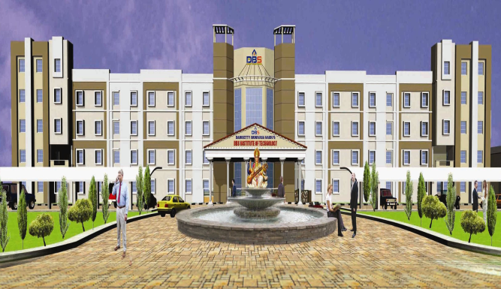
DAMISETTY SRINIVASA NAIDU’S
Chief Patron :
Sri D. Srinivasa Naidu
Chairman
Patrons :
Sri D. B. Suresh Babu
Secretary
Sri D. Sudheer Naidu
Correspondent
Co - Partons :
Dr. K.V.Reddi
Director
Sri G. Ramesh Babu
Administrative Officer
Chairman of the DbsEcstasy 2013 :
Dr. T. Venkateswara Rao
Principal
Convener :
Prof. A. Maheswara Reddy
HoD, ECE Dept.
Co-Conveners :
Prof. P. Vara Prasad
HOD, Mech Dept.
Mrs. U.V.. Sujala
HoD, EEE Dept.
Mr. K M Vara Prasad
HoD, CSE Dept.
Mr. M. Sreenu
HoD, Civil Dept.
Mr. G. Ramamurthy
HoD, H&S Dept.
Advisory Committee :
Dr. K. Sowndara Rajan
Prof. of ECE dept.,JNTUA
Dr. K. Varadarajulu
Project Manager, Motorola, Bangalore.
Dr. S.Varadarajan
Prof. of ECE Dept., SVUCE,Tirupathi.
Dr. M.N.Giriprasad
Prof. of ECE Dept., JNTUA
National Conference on
DBS INSTITUTE OF TECHNOLOGY
Advances in Technological Developments
NH 5, MADDURUPADU,
KAVALI -524 201, SPSR NELLORE DT.,
REGISTRATION FORM
16th February 2013
National Conference on
Advances in
Technological Developments
16th February 2013.
Name ______________________________
Year & Branch ________________________
College & Address:
_______________________________
_______________________________
_______________________________
Phone No :________________________________
E-mail Id: ________________________________
Signature of the applicant
Organized by
DAMISETTY SRINIVASA NAIDU’S
DBS INSTITUTE OF TECHNOLOGY
Affiliated to JNTU Anantapur, Approved by AICTE
An ISO 9001:2008 Certified Institution
NH 5, MADDURUPADU,
KAVALI -524 201, SPSR NELLORE DT.
Ph: 08626-211599, 08143713513
Website: www.dbsinstitutions.com
E-mail: dbsecstasy13@gmail.com
Date: Signature of HOD/
Place: Principal With Seal

Slide 2
DBS Institute of Technology was established with a vision by technocrats and industrialists. The institution is continuously supported by group of technocrats and industrialists and also guided by renowned professors. One of the unique features of this institution is not only adopting innovative teaching methods but also imparting practical knowledge by involving both the students and faculty in live projects.
The college has set exemplary standards with par excellence. The college has excellent facilities and infrastructure of global standards. The ambience of the institute induces learning and maintains the stay pleasant and educative.
Civil Engineering
Electrical & Electronics Engineering
Mechanical Engineering
Electronics & Communication Engineering
Computer Science Engineering
Located in a sprawling campus of 16 acres on Chennai – Kolkata National Highway (NH 5),at Maddurupadu, Kavali, SPSR Nellore Dt., A.P. The institute is well connected by rail & road. It is 60 Km from Nellore & 65 Km from Ongole.
ABOUT DBSIT
The main objective of this conference is to create awareness and also to provide the perfect platform for the participants to upgrade and share their knowledge and experience and to discuss on the ways to disseminates awareness of the latest developments and advances in the engineering fields.
CIVIL :
Green Building
Concrete Mix Design & Bitumen
Structural Analysis
Transportable Planning & design
Remote sensing & GIS
EEE :
Recent Trends in Power Electronics &
Drives
FACTS Controllers
Power Quality
Renewable Energy Sources
Control Systems
MECHANICAL :
Robotics
Refrigeration & Air Conditioning
Alternative Fuels
Design for Advanced Manufacturing
CAD/CAM
Advanced Thermal Engineering
ECE :
Acoustic Signal Processing
Wireless Data Networks (4G & 4.5G)
VLSI Design & Testing
Sensor Based Circuits and Applications
Nano Material Engineering
CSE :
Data Mining & Ware Housing
Advances in Web Technologies
Computer Security & Cryptography
Artificial Intelligence & Neural Networks
Computer Graphics & Virtual Reality
Last date for receipt of filled in registration form: 28-01-2013
Confirmation of Acceptance
by e-mail: 03-02-2013
Conference on : 16th February 2013
All the B.Tech. & M.Tech scholars are
Eligible.
Maximum of TWO students per Paper
No Registration Fee.
Free accommodation will be provided on request.
One way fare by the shortest route will be paid for each participant.
Photostat copies of the registration form can be used.
Contact Person :
Prof. A.Maheswara Reddy
CONVENER, HOD,ECE DEPT.
DBSIT , KAVALI- 524 201
SPSR NELLORE DT. – A.P.
Mobile : 08143713513, 08985006996
e-mail: dbsecstasy13@gmail.com
THE CONFERENCE THEME
AREAS OF THE CONFERENCE
IMPORTANT DATES
GENERAL INFORMATION
UNDER GRADUATE PROGRAMMES
LOCATION AND ACCESSIBILITY

